Slide 1
Models in science
Objectives
Understand why we use models to support explanations and predictions
Use models in explanations and predictions
Identify the limitations of different models explicitly
.
ITTECF Classroom Practice – Standard 4
Modelling helps pupils understand new processes and ideas; good models make abstract ideas concrete and accessible.
Notes:
The ideas that models are based on should be familiar to pupils, as otherwise this can confuse them further;
It is important that pupils understand how models differ from the idea being taught and learn the underlying idea rather than the model

Slide 2
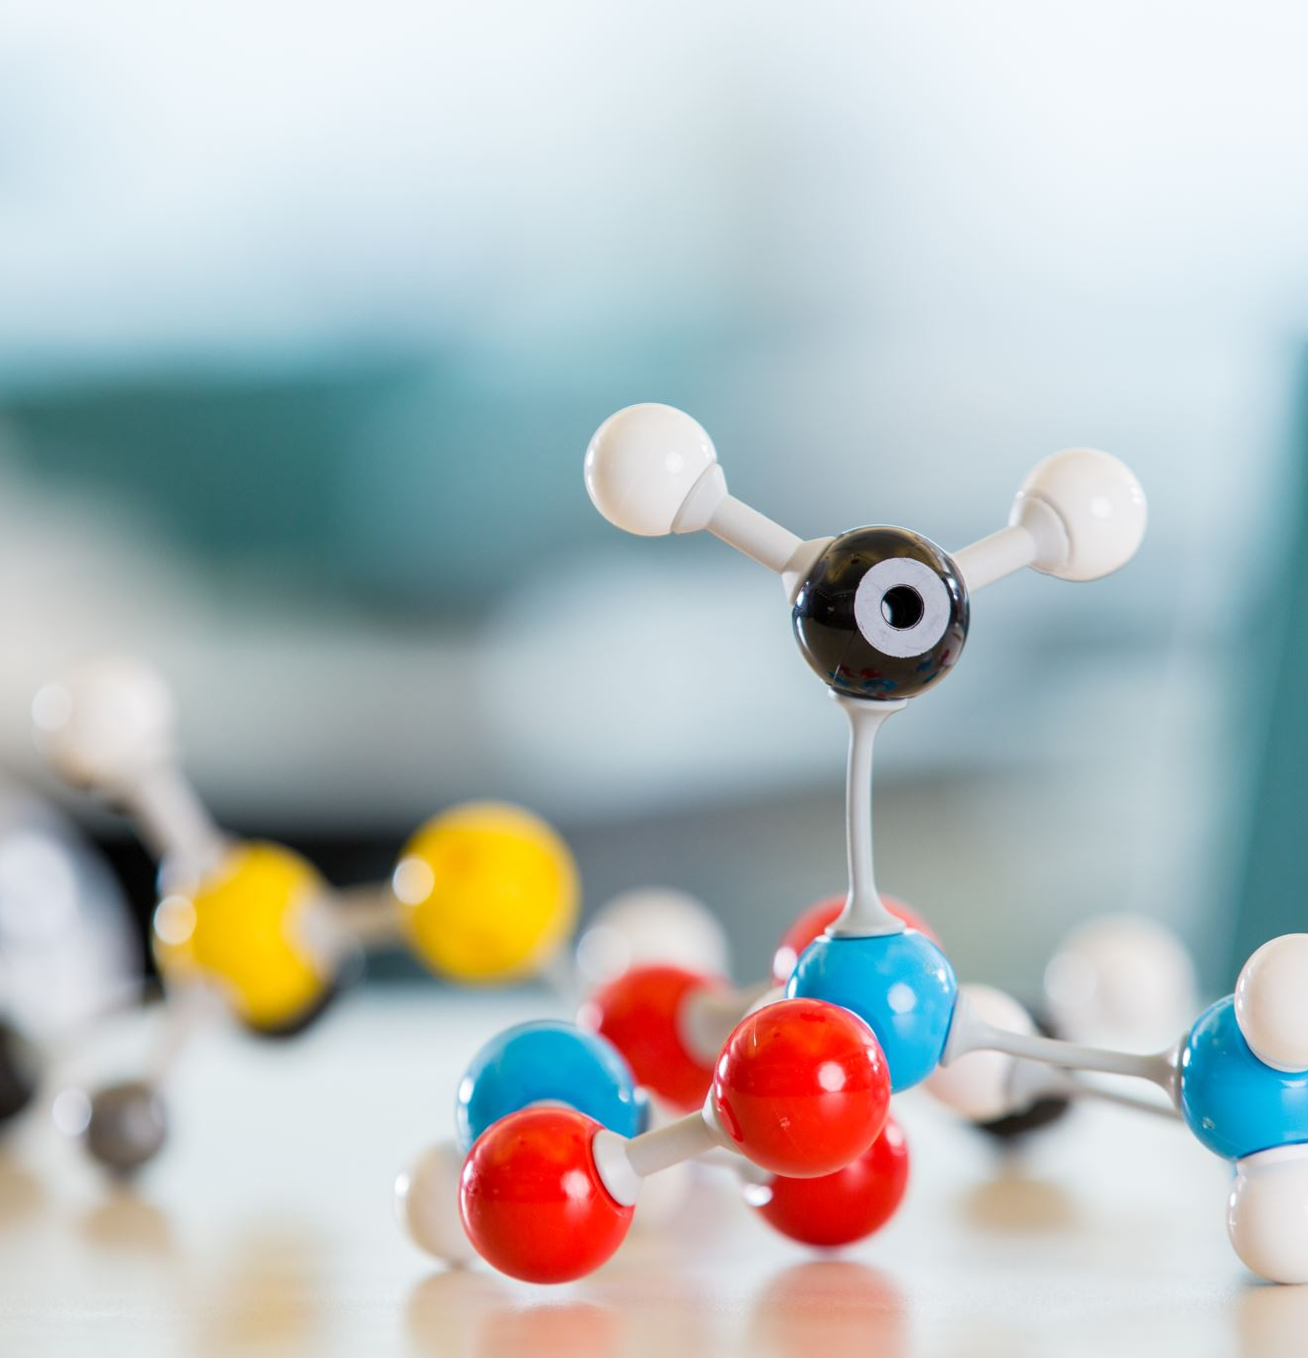
What do we mean by models?
In your groups, discuss what we mean by a model.
What examples of models you have seen or used -
In physics?
In biology?
In chemistry?
Why do we use models?

Slide 3
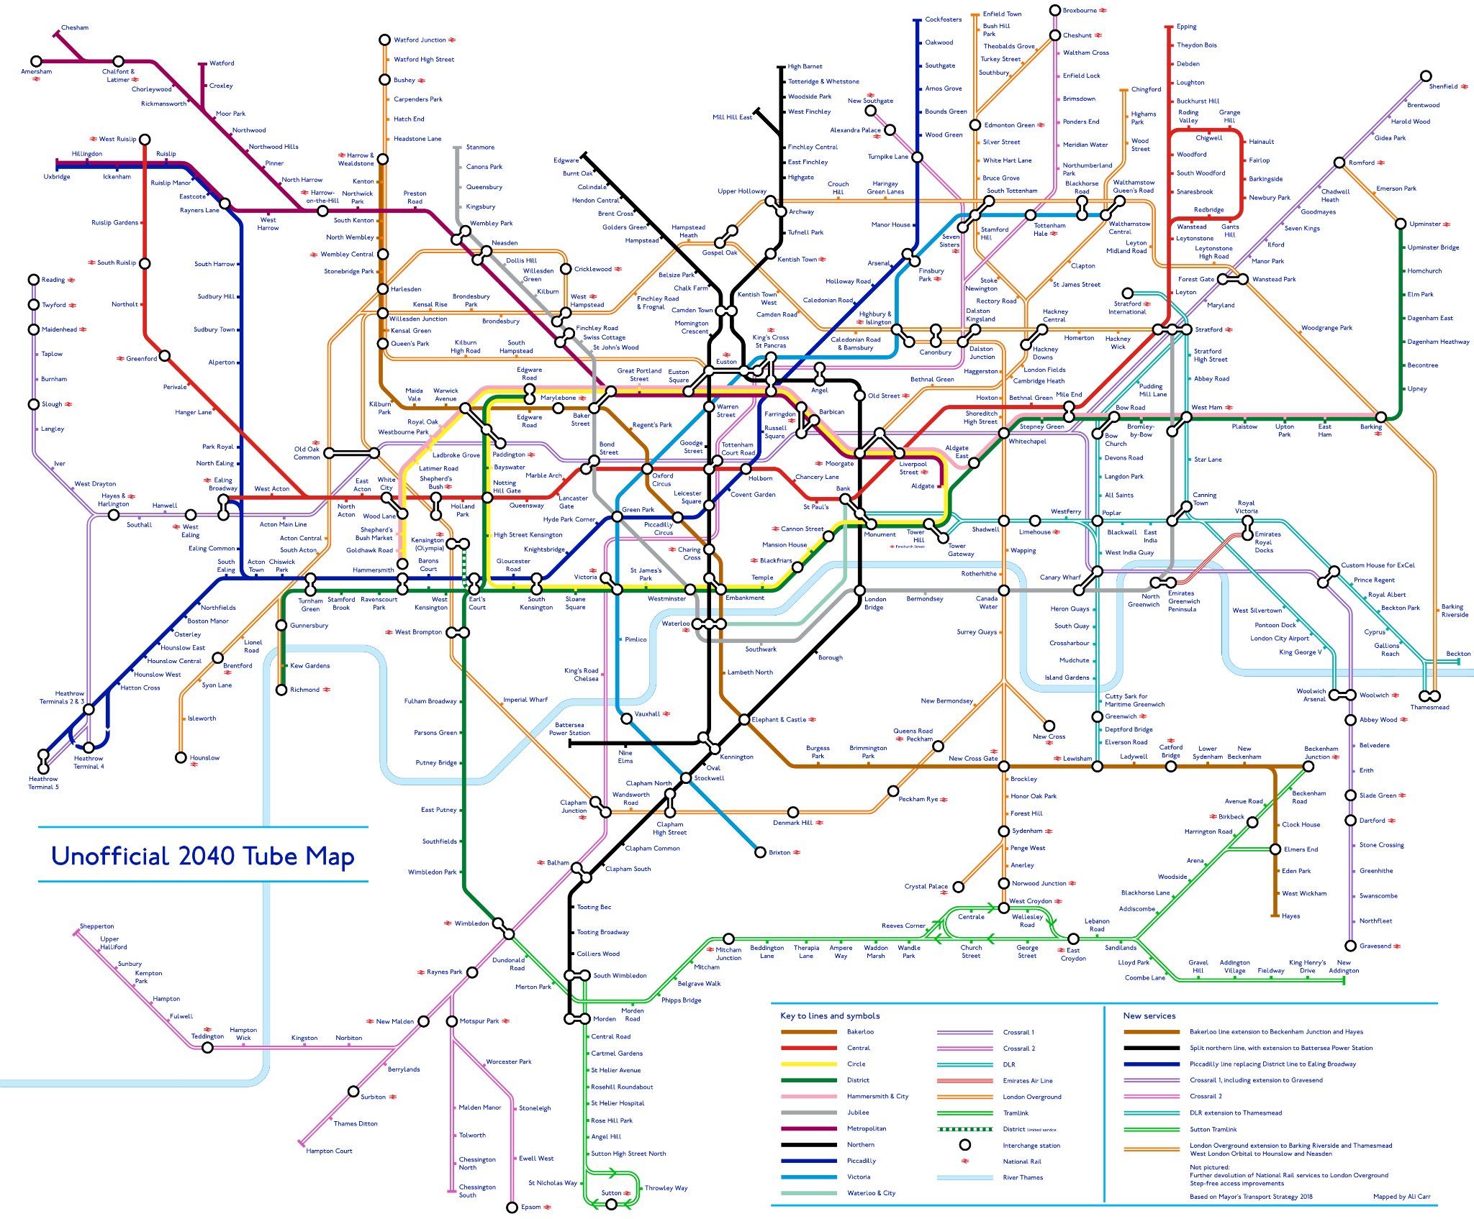
Here is an example model: What does it show? What are the pros and cons?
General

Slide 4
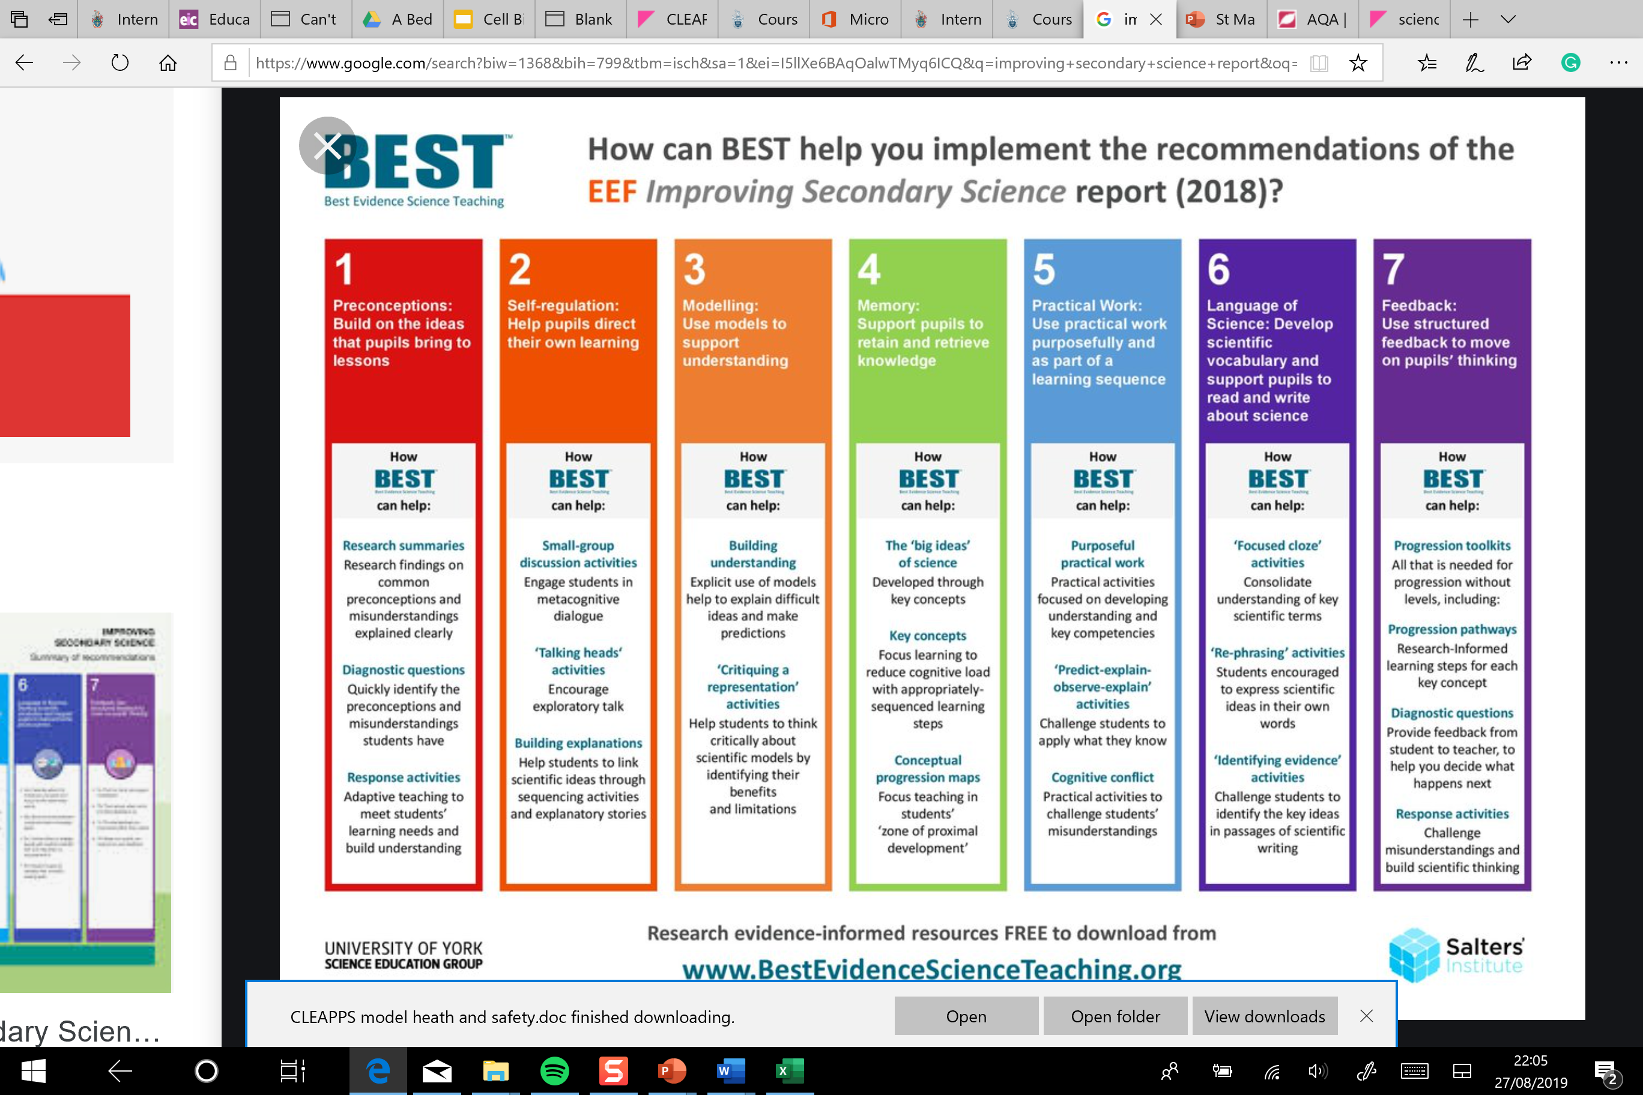

Slide 5
Commonly used models
Three dimensional models, for example a plastic ball-and-stick model of an organic molecule, a coloured plastic model of the human circulatory system
Verbal and written models, for example analogies such as the water flow analogy for electric current.
Mathematical models, for example equations of motion and chemical formulae.
Visuals such as graphs, diagrams, and animations
Computer models e.g. simulations of population growth.

Slide 6
Johnstone’s triangle
Chemistry education model showing chemical knowledge on three interconnected levels.
Macroscopic: phenomena that you can observe directly, e.g. identifying chemical changes in everyday life, such as cooking, rusting of metals, or combustion.
Submicroscopic: concepts that are too small to see, e.g. molecules, structures, geometry, polarity.
Symbolic: chemical symbols, formula/equations, diagrams, hazard warning symbols.
Improve students’ understanding with Johnstone’s triangle | Feature | RSC Education

Slide 7
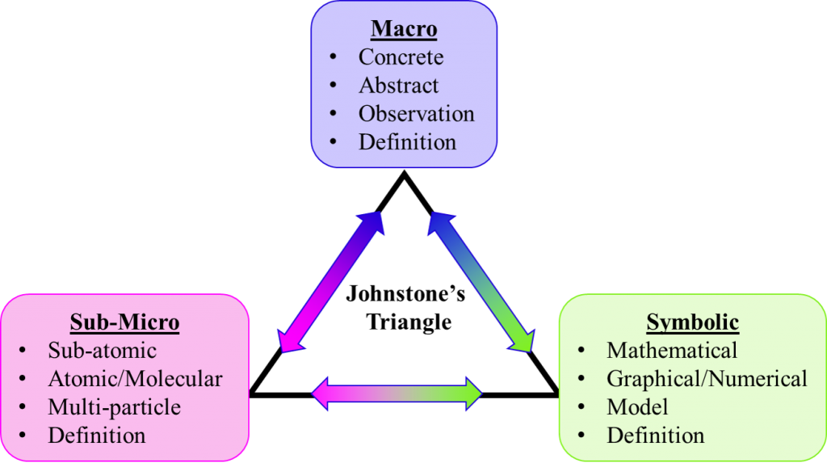
Linking between levels of description
Repeatedly building and reinforcing links between the levels is better than working between all three at once.
Johnstone, 1982
Notes:
Johnstone, A. (1982) Macro- and microchemistry, School Science Review 64 (227),pp.377-379

Slide 8
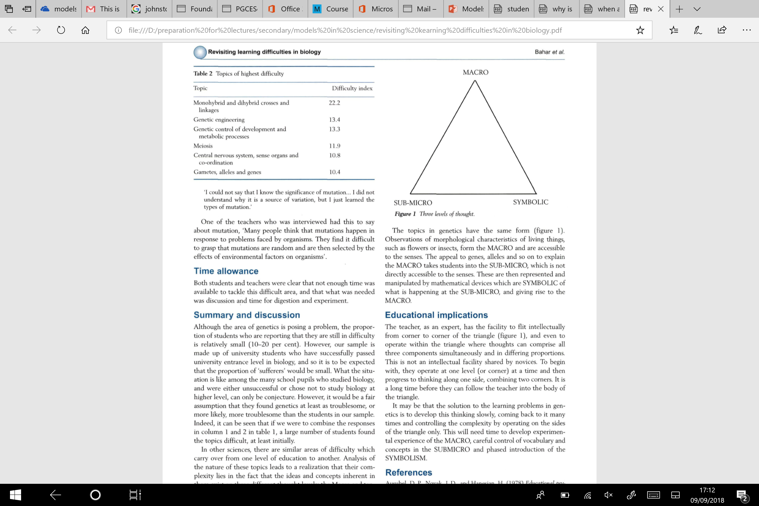
What the research says
Johnstone A. H., (1991), Why is science difficult to learn? Things are seldom what they seem J. Comput. Assist. Learn., 7, 75–83.

Slide 9
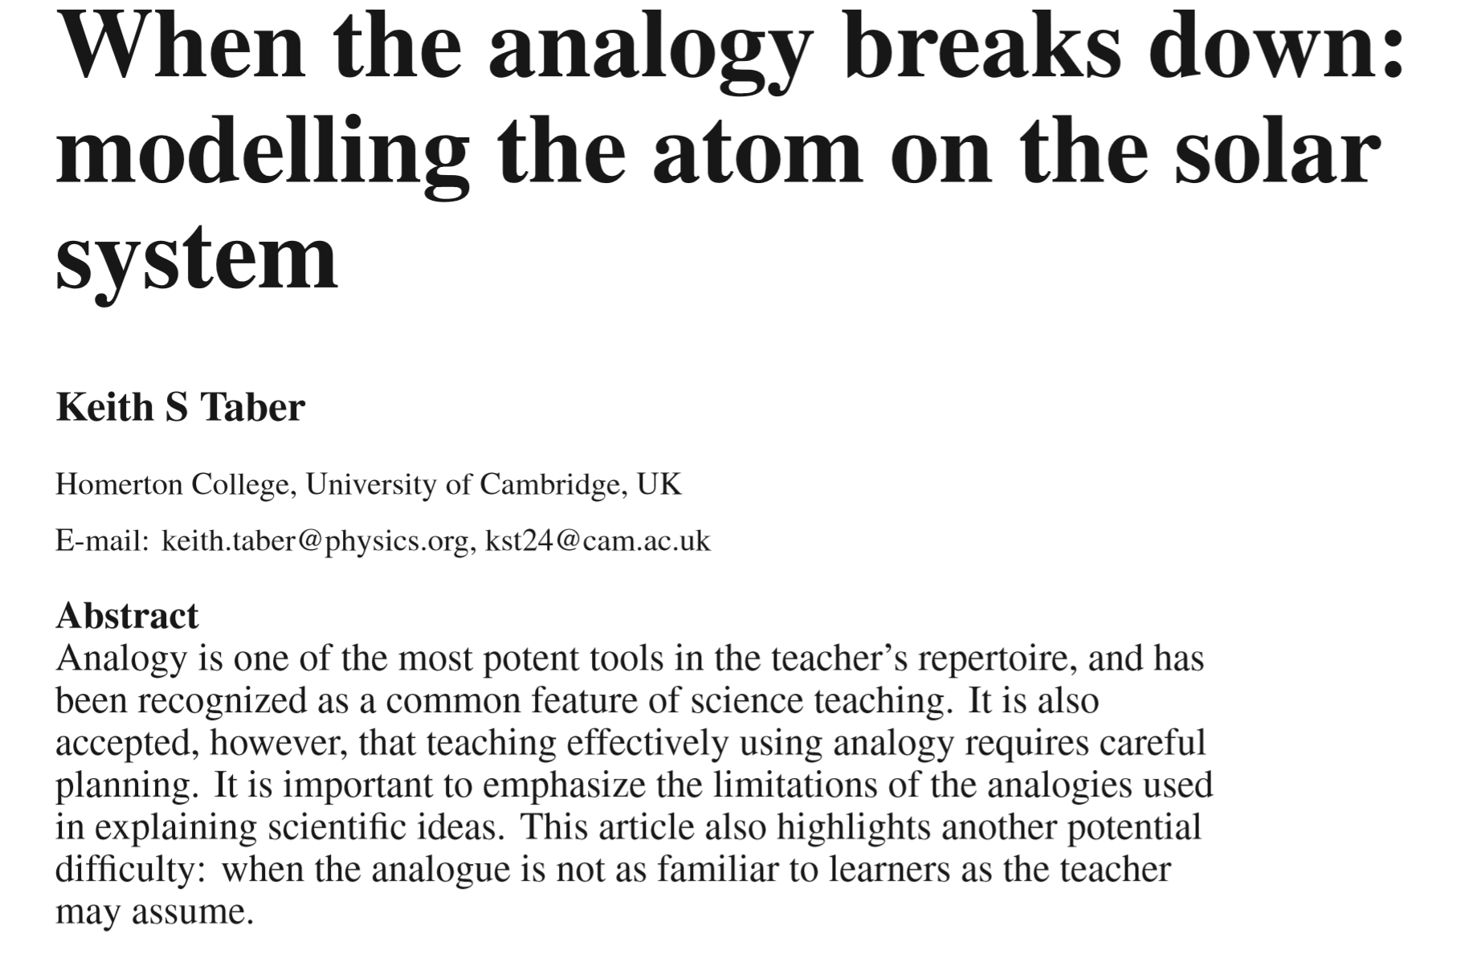

Slide 10
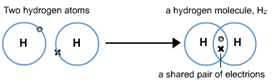
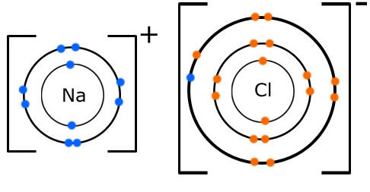
What are the advantages and disadvantages of these models?
Whoop! I am now happy because I have a full outer shell!
Taber K.S. (2006) Beyond Constructivism: the Progressive Research Programme into Learning Science. Studies in science education, 42(1) pp.125-18
Notes:
Take care! Dot and cross diagrams (for example) can help set up misconceptions.

Slide 11
Points to consider when teaching models
Teach students about models and get them thinking critically about their use
Teach students explicitly why we use models.
Discuss the strengths and weaknesses of the models you are using.
Use a number of different model types when teaching an idea.
Help students to see the links between phenomena that they experience, models that make sense of these experiences, and symbolic representations of phenomena.
Encourage students to develop their own models and share them with you and with their peers.
Notes:
Models are an essential part of developing and sharing scientific knowledge. Good teachers use them all the time, to provide a bridge between students’ current ideas and new understanding. Models are ways of thinking about the ‘real thing’, and there are many kinds. Diagrams are models, and so are analogies, 3D molecular models and mathematical formulas like F = mA. By being explicit about models, you can help your students understand their own thinking. By inviting them to comment on and improve models, and to invent their own, you can give them extra insights. Models have been around for as long as scientists have been explaining their ideas to one another (Figure x). Models fit naturally within the teaching of science, and are indeed a key part of science exploration. Models are an essential tool for scientists because science often involves working with phenomena and concepts which are inaccessible to our everyday senses. They may be too large to see such as the solar system, too small such as atoms, too slow such as evolution, too fast such as some chemical reactions, or just ‘invisible’ such as most of the electromagnetic spectrum.

Slide 12
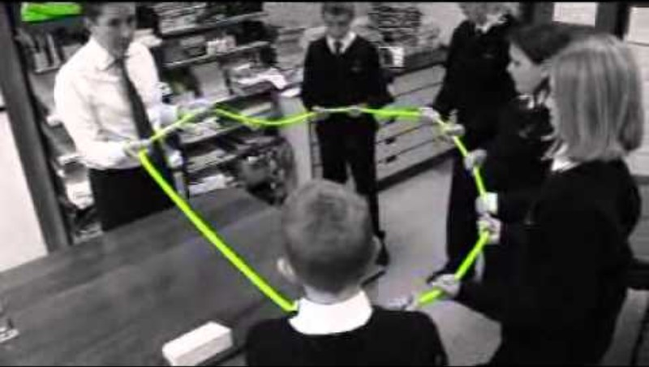
Electric circuit models

Slide 13
Using models effectively in teaching – FAR approach
Focus
Concept – is it difficult, unfamiliar or abstract?
Students – what ideas do the students already have about the concept?
Analogue – is it something students are already familiar with?
Action
Likes – discuss the features of the analogue and the science concept.
- draw similarities between the analogue and target.
Unlikes – discuss where the analogue is unlike the science concept.
Reflection
Conclusions – was the analogy clear and useful, or confusing?
Improvements – refocus as above in light of outcomes.
USEFUL RESOURCES FROM THE ROYAL SOCIETY OF CHEMISTRY​
https://edu.rsc.org/feature/reflect-on-your-use-of-models/3010509.article ​

Slide 14
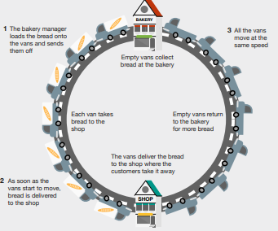
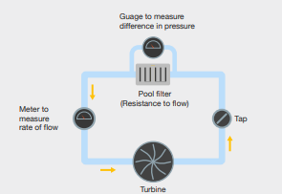
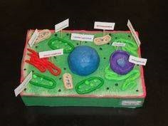
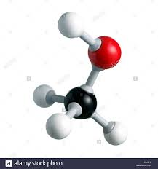
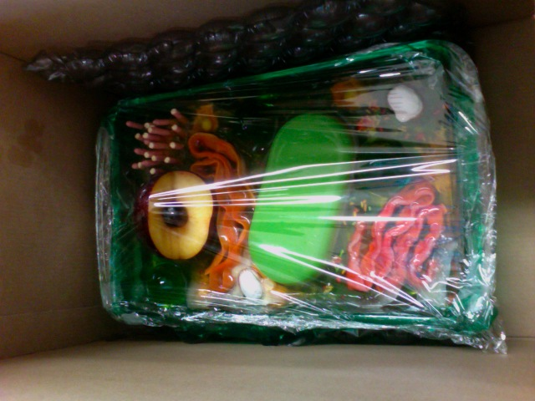

Apply the focus and action sections of the FAR tool to a model in your subject discipline

Slide 15
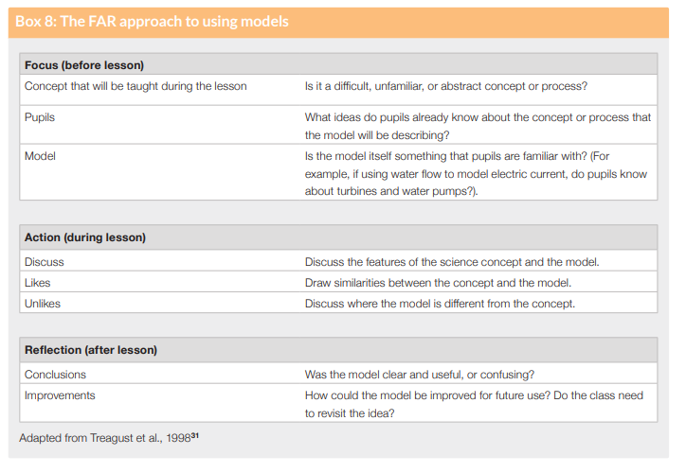
What models could you use to explain:
- the relative size/spacing of the planets
- kinetic theory (conduction or diffusion etc)
- covalent bonding
- differences between alpha, beta and gamma radiation
- atomic structure
- different types of waves (longitudinal and transverse)
- exponential growth

Slide 16
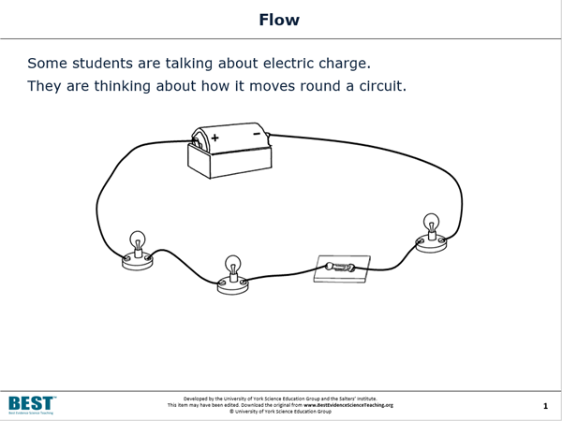
An example assessment in physics

Slide 17
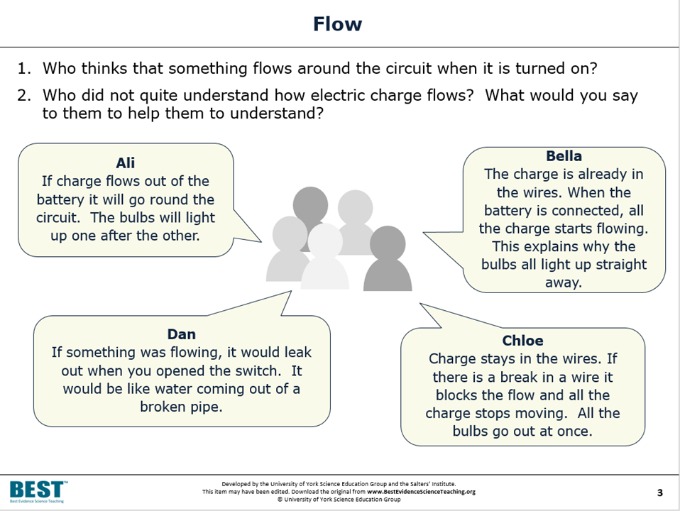
Where have students got confused?

Slide 18
References
Bahar. M , Johnstone.A.H. & Hansell, M.H. (1999) Revisiting learning difficulties in biology, Journal of Biological Education, 33(2), 84-86,
Harrison, A.G & Treagust, D.F (2000) A typology of school science models, International Journal of Science Education, 22:9, 1011-1026, DOI: 10.1080/095006900416884
Gericke, N., Hagberg, M. & Jorde, D. (2013) Upper Secondary Students’ Understanding of the Use of Multiple Models in Biology Textbooks—The Importance of Conceptual Variation and Incommensurability. Reseach in Science Education 43(2) pp.755–780
Taber K.S. (2006) Beyond Constructivism: the Progressive Research Programme into Learning Science. Studies in science education, 42(1) pp.125-18

